Slide 1
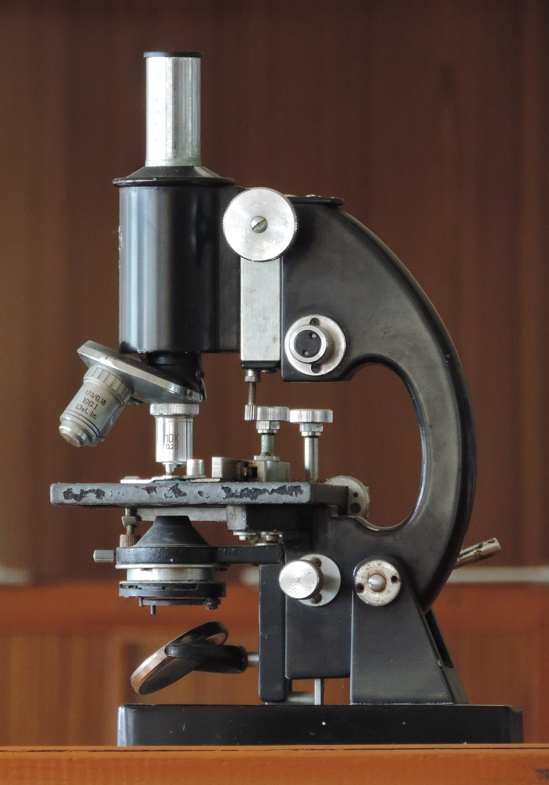
Title: Key concepts and principle in Environmental biotechnology
Subtitle: Understanding the Role of Biotechnology in Environmental Management.
Department: M.Sc. Environmental Science
Enrolment Number: 2411272110004
Institute: Parul University of Applied Science
Student: Nyran Abraham Tahija
Lecturer: Dr. Pankaj Kumar
Date: 18/02/2025

Slide 2
Presentation Outline
Introduction to Environmental biotechnology
Micro-organism in Environmental biotechnology
Bio-remediation in Environmental biotechnology
Wastewater treatment using biotechnology
Bioenergy and renewable resource
Phytoremediation and green solution
Genetic Manipulation strategies in Environmental biotechnology
2. Ethical and Sustainable Considerations
3. Conclusion and Future Perspectives
4. Reference

Slide 3
Introduction to Environmental biotechnology
Environmental biotechnology applies biological processes to solve environmental problem and sustainably mange natural resource. It utilize living organism, cells, and biological system to develop technologies for environmental protection, waste treatment, and pollution remediation. Environmental biotechnology work towards sustainable practices, conservation of biodiversity, and minimizing environmental degradation.
The main objective of environmental technology aims to develop sustainable technologies for efficient pollution and control remediation, conservation of biodiversity, and sustainable use of natural resources.
It supports sustainable development by reducing environmental degradation and promoting eco-friendly industrial processes (Das & Dash, 2020). Key benefits include improved wastewater treatment, air purification, and biodiversity conservation (Rittmann, 2018).
Key Areas
Waste Management: Microbial processes treat solid and liquid waste, minimizing pollution.
Bioremediation: Uses microorganisms and plants to remove pollutants from soil, water, and air.
Bioenergy: Develops biofuels and biogas from organic waste, reducing fossil fuel dependence.
Conservation: Enhances biodiversity through genetic resource management and sustainable practices.

Slide 4
Micro-organism in Environmental biotechnology
Microorganisms play a crucial role in bioremediation, the process of using biological agents to remove or neutralize contaminants from the environment. Bacteria, fungi, and algae contribute significantly to waste degradation, pollutant removal, and nutrient cycling in ecosystems.
Bacteria are the most widely used microorganisms in bioremediation due to their rapid adaptability and diverse metabolic capabilities. They degrade organic and inorganic pollutants, including hydrocarbons, heavy metals, and industrial waste. (e.g. is Bacillus subtilis, Nitrifying bacteria, Pseudomonas putida )
Fungi, especially filamentous fungi, are effective in breaking down complex organic pollutants such as dyes, pesticides, and petroleum products. They release extracellular enzymes that degrade contaminants into simpler, less harmful substances. ( e.g. Penicillium spp & white-rot fungi)
Algae play a key role in wastewater treatment by absorbing nutrients, heavy metals, and carbon dioxide while producing oxygen. They also contribute to phycoremediation, a process where algae remove pollutants from water bodies. (e.g. Nannochloropsis spp & Chlorella vulgaris)
Microorganisms drive essential biogeochemical cycles, breaking down organic and inorganic materials to maintain ecosystem balance.

Slide 5
Bio-remediation in Environmental biotechnology
Bioremediation is a process that uses microorganisms, plants, or enzymes to degrade, detoxify, or remove pollutants from contaminated environments, restoring ecological balance in a sustainable manner.
Types of Bioremediation
In-situ ( On-site treatment) | Ex-situ (Off-site treatment)
Bio-venting | Land-farming
Bio-stimulation | Compost
Bio-augmentation | Bioreactors
Bio-sparging- a remediation technique that involves injecting pressurized air or gas into contaminated soil to promote the breakdown of pollutants by microbes. | Bio-piles- are a type of biological treatment system used to remediate contaminated soil, sediment, or other materials. They are essentially large piles of contaminated material that are aerated and maintained under controlled conditions to promote the growth of microorganisms that break down the contaminants.

Slide 6
Wastewater treatment using biotechnology
Wastewater is any water that has been contaminated by human activities, typically through industrial, or agricultures process. It contain variety of pollutants, including organic matter nutrient (N,P,K) and heavy metals, pathogens and other harmful substance. Proper treatment is essential to protect human health, aquatic ecosystem, and the environment. (e.g. Pseudomonas putida, E. Coli)
Wastewater treatment involves several stages to remove contaminants and make the water safe for discharge or reuse;
Primary treatment | Secondary treatment | Tertiary treatment | Advance treatment
Screening and grit removal | 1. Activated sludge process | 1. Filtration | 1. Nutrient removal
Large debris is removed through screens, and grit like sand and gravel is settled out. | Wastewater is aerated and mixed with micro-organism. Micro-organism consume organic matter, reducing BOD and suspended solids. | Wastewater passes through sand, gravel, or other filtration media to remove remaining suspended particles. | Additional processes remove excess nitrogen and phosphorus to prevent eutrophication
2. Sedimentation | 2. Trickling filters and rotating biological contactors. | 2. Disinfection | 2. Reuses and Resource Recovery
Wastewater is held in tanks, allowing solids to settle as sludge, and oils and fats to float as scum. | Wastewater is distributed over a medium to promote microbial growth, which degrade organic matter. | Chemicals (e.g.; chlorine, ozone, UV light) are used to killed remaining pathogens and bacteria. | Advanced treatment allow for the safe reuse of treated waste water for irrigation, industrial purpose, or even drinking water in some cases.

Slide 7
Bioenergy and renewable resource
Bioenergy is derived from biological sources and serves as a renewable alternative to fossil fuels. It reduces carbon emissions and promotes sustainability.
Types of Biofuels
Biodiesel – Produced from algae and vegetable oils; a cleaner alternative to petroleum diesel.
Bioethanol – Made from fermenting sugarcane, corn, or cellulose; used as a gasoline substitute.
Biogas – Composed of methane, generated from organic waste decomposition through anaerobic digestion.
Advantages of Bioenergy
Carbon-Neutral: Reduces greenhouse gas emissions by recycling atmospheric CO₂.
Sustainable: Derived from renewable biomass sources.
Waste Utilization: Converts agricultural and organic waste into energy.
Challenges of Bioenergy
High Costs: Production and refining technologies require significant investment.
Efficiency Issues: Some biofuels have lower energy output than fossil fuels.
Land Use Concerns: Large-scale biofuel production competes with food crops, impacting food security.

Slide 8
Phytoremediation and green solution
Phytoremediation is a green technology that uses plants to remove pollutants from soil, water, and air. It's an environmentally friendly and cost-effective way to clean up contaminated areas. (e.g. Sunflower)
Types of phytoremediation
Phytoextraction; Plants absorb metals from the soil and transport them to their leaves and shoots, where they can be harvested and removed
Phyto stabilization: Plants use their roots to bind contaminants in the soil, preventing them from moving into groundwater
Phytodegradation: Plants and microorganisms work together to break down pollutants like herbicides and chlorinated solvents
Phytovolatilization: Plants absorb water and contaminants from the soil, then release the contaminants as gases into the air
Rhizofiltration: A combination of phytoextraction and Phyto stabilization, this technique uses plants to absorb, concentrate, and precipitate contaminants from water.
Phytoremediation is an environmental biotechnology that uses plants to clean up pollutants in soil and water. It's a cost-effective and eco-friendly technique.

Slide 9
Genetic Manipulation strategies in Environmental biotechnology
Environmental genomics and synthetic biology use advanced genetic tools to study and engineer microorganisms for pollution control and ecosystem restoration. Using DNA sequencing to study microbial communities in polluted sites.
Genetic engineering | Gene cloning | Recombinant DNA technology | CRISPR-Case9 technology
Genetic engineering it involves modifying of an organism genetic material using molecule techniques (CRISPR-case9 technology) | Is a crucial techniques that were we can isolate and make copies of a specific gene to produce large quantities of a particular protein of enzymes | It involves the combining DNA form different sources to create genetically modified organism(GMO) with desired characteristics. | It is a revolutionary tool for precise gene editing and modification in organism.
Enables the development of organism with enhance capabilities for environmental application like pollution clean up etc. | Essential for engineering microorganism with desired traits for environmental purposes | Used to develop organism capable of pollutant degradation, nutrient cycling, or other environmental function | This technology allows targeted modification the genome to enhance environmental performance of organism.
By employing these genetic manipulation strategies, were essential empowering organism become to environmental superheroes. These technology enable us to finetune and optimize their abilities to address critical environmental challenges. They hold immense promise for sustainable future where we work hand in hand with nature to restore and protect our precious environment.

Slide 10
Conclusion and Future Perspectives
Environmental Biotechnology for Sustainable Development:
Essential for pollution control, waste management, and biodiversity conservation.
Supports climate change mitigation through nature-based solutions.
Innovations in Microbial Engineering, Bioenergy, and Ecosystem Restoration:
Microbial Engineering: Engineered bacteria for bioremediation and waste decomposition.
Bioenergy: Advancements in biofuels (biodiesel, biogas) as alternatives to fossil fuels.
Ecosystem Restoration: Biotechnological approaches for reforestation, soil restoration, and coral reef conservation.
Future Focus Areas:
AI-Driven Bioremediation: Machine learning to optimize pollutant breakdown.
Circular Bioeconomy: Sustainable biomass utilization for renewable products.
Climate Resilience: Biotechnology solutions for carbon capture, water purification, and adaptive ecosystems

Slide 11
Reference
Das, S., Dash, H. R., & Chakraborty, J. (2014). Microbial Biodegradation and Bioremediation. Elsevier.
Glazer, A. N., & Nikaido, H. (2017). Microbial Biotechnology: Fundamentals of Applied Microbiology (2nd ed.). Cambridge University Press.
Jansson, J. K., & Hofmockel, K. S. (2020). "Soil microbiomes and climate change." Nature Reviews Microbiology, 18(1), 35-46. https://www.nature.com/articles/s41579-019-0265-7
Rittmann, B. E. (2018). Opportunities for renewable bioenergy using microorganisms. Biotechnology and Bioengineering, 115(7), 1649-1658.
Singh, A., & Ward, O. P. (2004). Biodegradation and Bioremediation. Springer.

